Slide 1
Using Eye Tracking Software in Psychological Research: A Hands-On Learning Experience
John Shelley-Tremblay, Ph.D., University of South Alabama

Slide 2
Workshop Description
This workshop explores the theory and methodology of human eye tracking for psychological research.
Fundamentals of eye movements, including saccades, fixations, and regressions will be discussed.
Equipment will be provided for hands-on practice with eye-tracking software and hardware.

Slide 3
Learning Outcomes
At the end of the workshop, participants will be able to:
Identify the scientific terminology of eye tracking.
Describe abnormal eye movement behavior as seen in recordings.
Describe the abnormal eye movements found in Specific Reading Disability, and their clinical significance.
Articulate how to design, implement, and analyze a basic eye-tracking experiment using OGAMA 5.0 software.

Slide 4
Reading involves many processes.
Physiological
Cognitive
Communication
Psycho-social
Physiology is the science dealing with the functions and vital processes of living organisms.

Slide 5
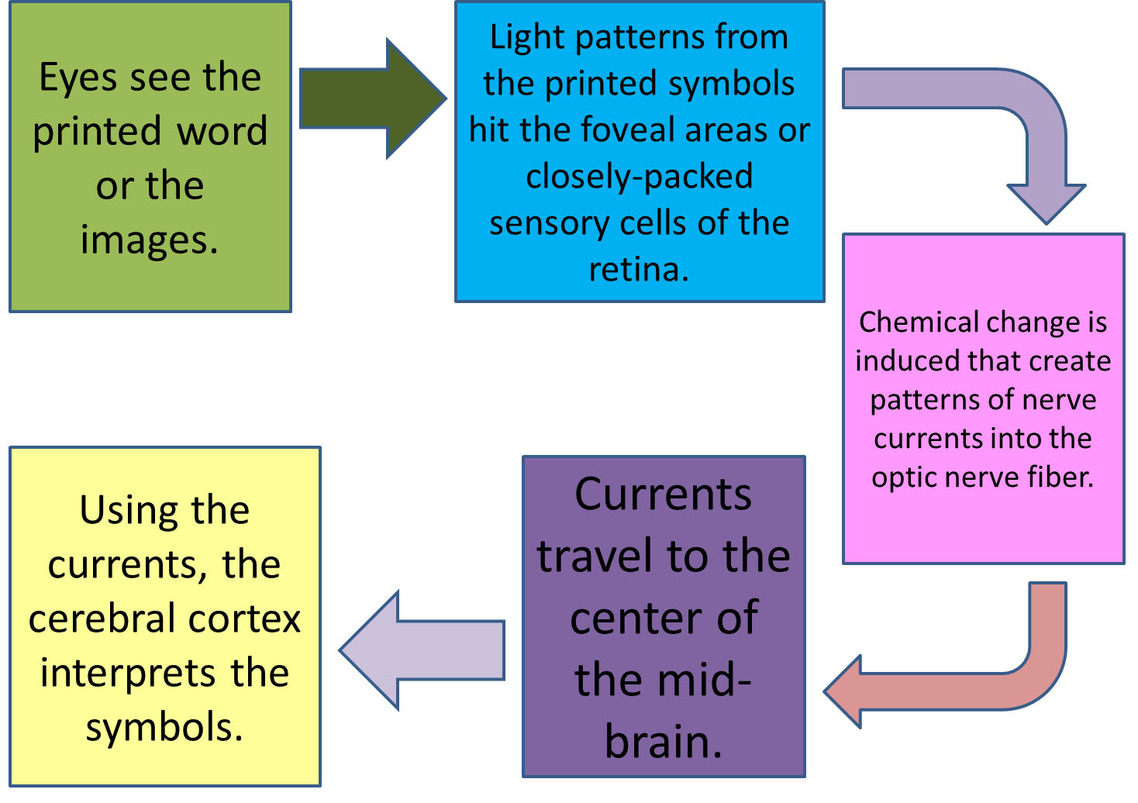
Reading involves many processes.
Physiological
Cognitive
Communication
Psycho-social
Physiology is the science dealing with the functions and vital processes of living organisms.

Slide 6
Reading involves many processes.
Physiological
Cognitive
Communication
Psycho-social
What are the different eye movements involved in reading?

Slide 7
What are the different eye movements involved in reading?
Fixation
Eyes stopping or getting fixated on the word or words
The duration of fixation is the length of time the eyes has to pause.
Inter-fixation
Eyes moving from stopping point to the other
Return Sweeps
Eyes swinging back from the end line to the beginning of the next line
Saccades
Short quick hop and jump movements done especially by literate people to move ahead on a line of print
Regressions
Backward right-to-left movement in case there is a need to double check what is being read

Slide 8
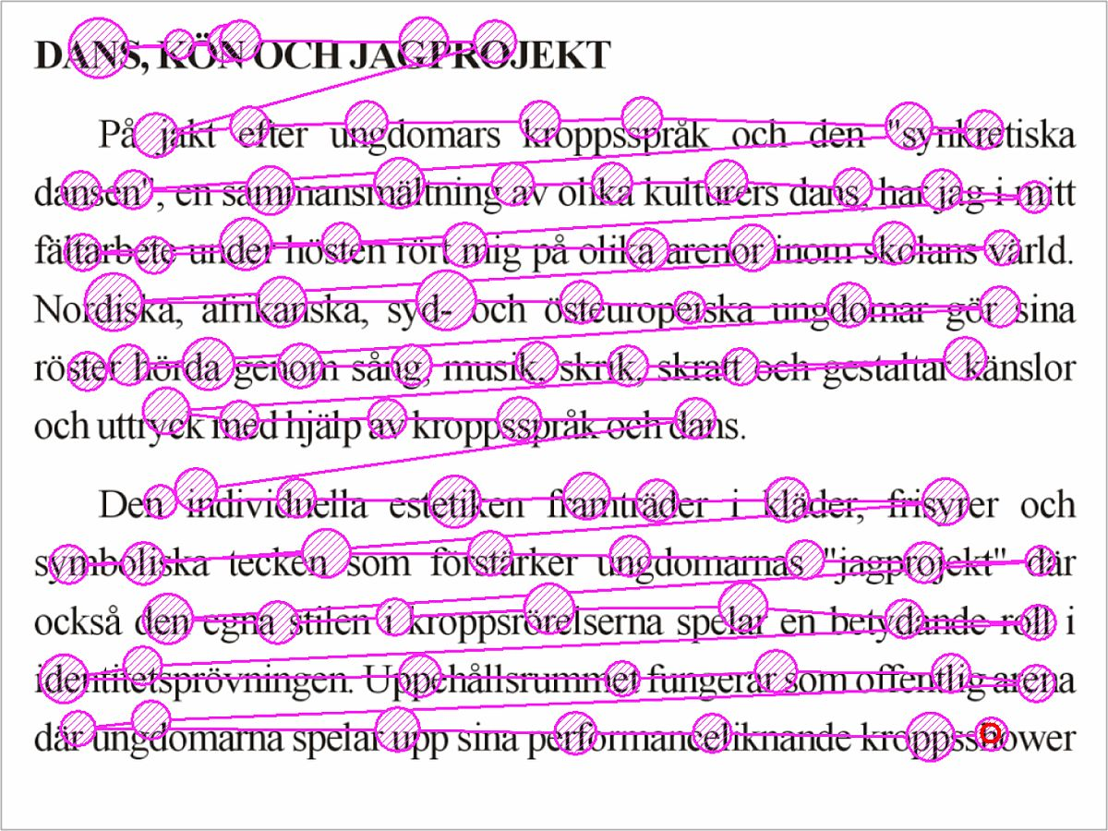
Fixation-Saccade Sequence

Slide 9
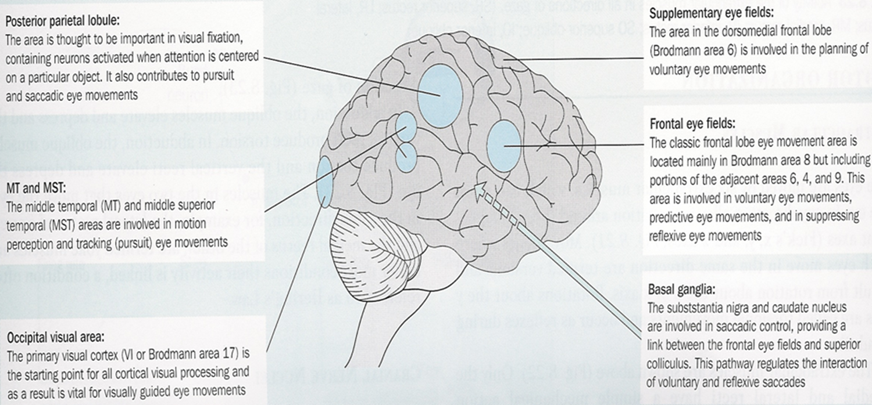
Variety of pathways contribute to saccadic control and smooth pursuit

Slide 10
Saccades
Under the control of three different areas in the brain:
Voluntary saccades - frontal eye fields (Brodmann’s area 8)
Reflexive saccades to complex stimuli - parietal lobes (Brodmann’s area 7)
Reflexive saccades to elementary stimuli - superior colliculi
Rapid rotation of the eyes that bring images onto the fovea.
Saccades are made spontaneously in response to a sudden appearing object, or to scan a scene or to read.
Thus, saccades can be either voluntary or reflexive.

Slide 11
Smooth Pursuit
Two types:
Voluntary (actually termed “smooth pursuit”) movements - originate in the temporo-parietal lobe
Reflexive - which are under vestibular nuclear control alone and constitute what is called the vestibulo-ocular reflex (VOR).

Slide 12
Do eye movement problems cause reading problems?
Evidence is mixed.
Most research points to “No.”
Some research suggests a causal link, but often these studies do not control for attention/ADHD or non-specific developmental pathologies.
Eye movements are a
Reliable
Sensitive
Stable
Marker for reading problems
Shown to occur in people with Specific Reading Disability/Dyslexia
Shown to Improve after SOME training programs.
Why? Improvements in functional connectivity yield improved visual attention.

Slide 13
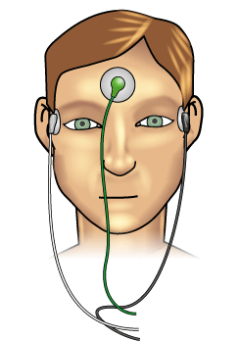
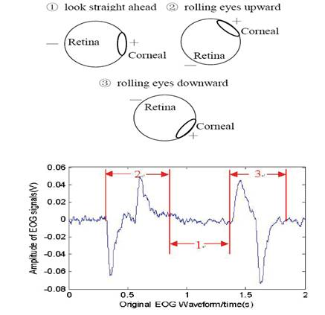
EOG
Cheap
Fast
Can be precise: Need proper calibration task
Can easily integrate VEOG for up/down
Vulnerable to head movements, chin rest or bite bar recommended.
Best for relative comparisons (not between subjects)
Use fixed distance, same stimuli

Slide 14
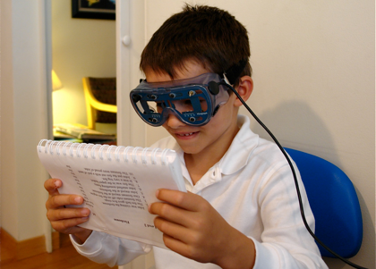
Infra-red
Lower Cost
Like optical EOG
No sensors attached
Good for children and certain clinical populations: Developmental Disorders
Let’s check out the VISAGRAPH II!

Slide 15
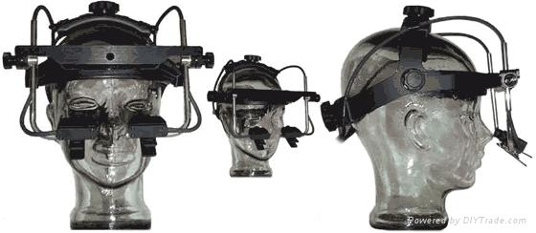
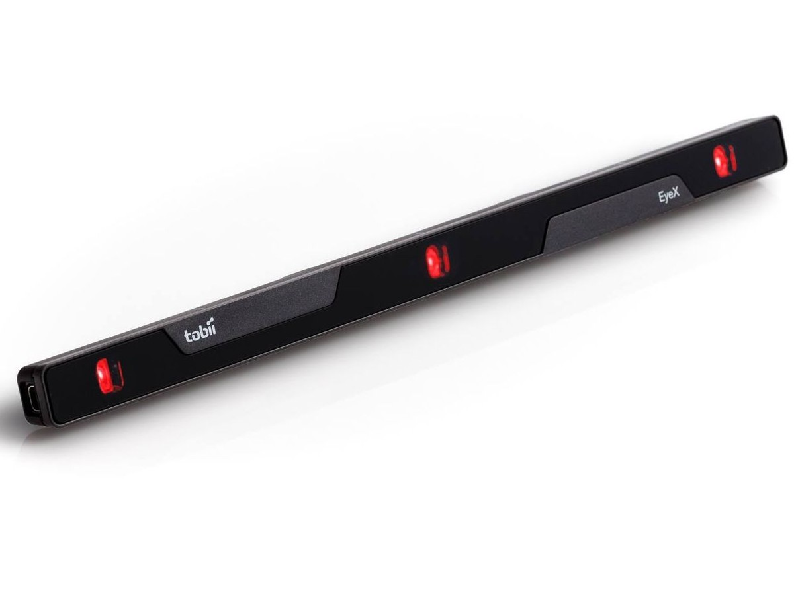
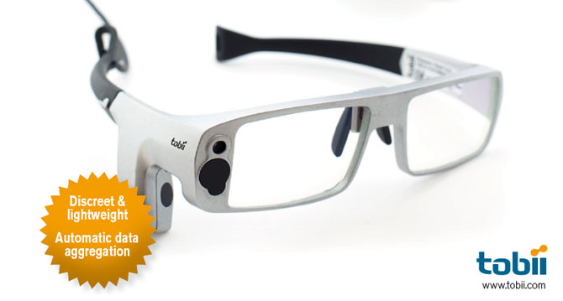
Optical
Corneal reflectance
Pupil Boundary Detection Algorithms
Face/Eye tracking combined
Head Mounted
Remote (desktop)
Wearable

Slide 16
Design of Experiments for Eye-Tracking
Data is NOT interpretable beyond the constraints of the experimental design.
Can only isolate cognitive processes strictly through control and experimental conditions.
Must be aware of measurement modality-specific artifacts and problems.
Requires adequate trials and limited conditions.
Example Experiment:

Slide 17
Issues to Control
Lighting! Hold constant within and between subjects
Pupil Size changes with luminance
Cameras very sensitive to lighting, particularly glint
Distance from subject to screen
80 cm (arms length) is common
Creates constant visual angle
Pupil size smaller farther away
Screen size (resolution: 1024 x 768 svga default), aspect, wide or normal
Distance of camera(s) from eyes. Remain constant. Very sensitive
May use chin rest/bite bar (less/more invasive)

Slide 18
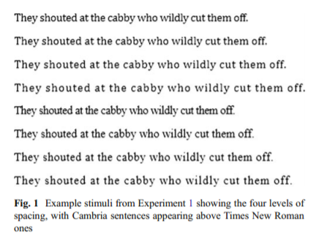
Spacing Effects
Slattery, T. J., & Rayner, K. (2013). Effects of intraword and interword spacing on eye movements during reading: Exploring the optimal use of space in a line of text. Attention, Perception, & Psychophysics, 75(6), 1275–1292. https://doi.org/10.3758/s13414-013-0463-8
Varied one element at a time. Inter-letter distance vs. inter-word distance, combined factorially.

Slide 19
OGAMA
Free: http://www.ogama.net/
Files: http://ogama.codeplex.com/
Installation
Windows XP, 7, 10 (7 seems best)
Microsoft .new framework 4.0 or later
Apple Bonjour
In this order
Manual: http://www.ogama.net/sites/default/files/pdf/OGAMA-DescriptionV25.pdf
Camera!

Slide 20
Sony PS3 Eye Camera
Great, low cost USB “webcam”
Close and far zoom setting
Includes 1 blue and one IR (red) LED near camera.
Has IR Filter installed from factory
Easy to remove: https://www.youtube.com/watch?v=X7Wg7li8_qM
Once removed, only works for HEAD Mounted, unless you buy a new lens.
This is fine, however, as head mounted removes problem of head movement.
Download driver for PS3 Eye for Windows
https://codelaboratories.com/downloads/
Install .exe
Verify PS3eye is working by launching the ap

Slide 21
OGAMA Modules
Slide Show
Design your experiment
Supports text, images, .pdf, movies, sound
Allows for bulk import
Supports mouse, keyboard inputs
Supports TTL triggering for interface with BIOPAC, other products, EEG
Supports correct/incorrect and feedback
Randomization/blocking

Slide 22
Record Module
Setup Tracker
Select Open Source Trackers
Choose ITU GazeGroup, hit OK. Make sure machine detects your camera.
Connect to camera
Configure Camera (demo)
Configure tracking
Pupil
Eye
Glint
Light sources
Calibration: defaults are OK
Options: Enable Eye Mouse

Slide 23
Record Module
Hit Record button!
Goes through each of your slides, in order, unless you change the order with the “linking” feature.
End can be a time out or an event like button or mouse.
Write data to database.
Subjects are not separate files, but are stored in DB built in.
Can be exported to .txt
Can be analyzed in other software (TOBII, SMI, SR-RESEARCH, etc…)

Slide 24
Various visualization modules
Let you visualize your data in different cool ways
Heat maps, scan paths, etc…
Chose based on the point you wish to make in your article.
Make sure to hit “Recalculate” any time you make a change.
AREA OF INTEREST MODULE:
Critical!
Can define in slide show, or post-hoc.
Defined according to questions of interest.
Ex: Sentence reading; Function vs. content words, nouns vs. verbs, noun markers, etc.
Use circles, rectangles, or free-hand. AOI templates may be saved, exported, imported

Slide 25
Statistics
Statistics most important module.
Lets you output a tab delimited txt file for easy import to excel, R, SPSS, etc.
Choose variables of interest and how many subjects.
Can compute by AOI

Slide 26
