Slide 1
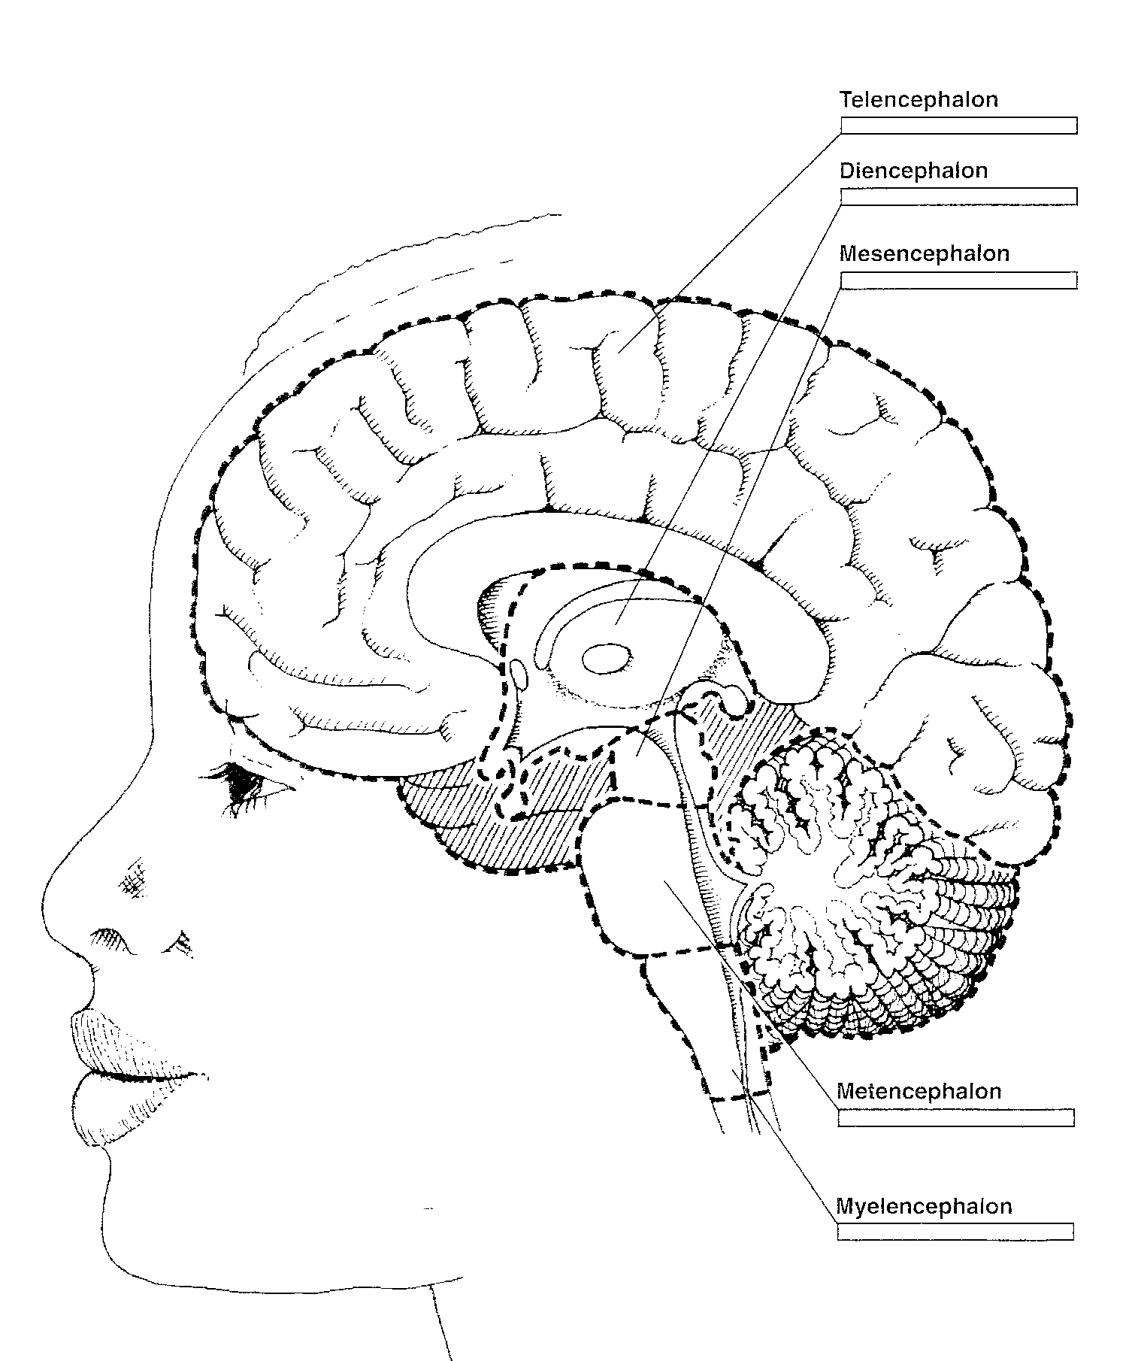
5.
Major Brain Structures
from the
Bottom-Up
4.
3.
2.
1.

Slide 2
Major Brain Structures from the Bottom Up
1. Myelencephalon: (Hindbrain)
Medulla: the most posterior region of the brain stem.
Pyramids: carry signals for voluntary movement from the cortex to the motor circuits of the spinal cord.
Olives: nuclei connected to the cerebellum
Reticular formation: arousal, sleep attention.

Slide 3
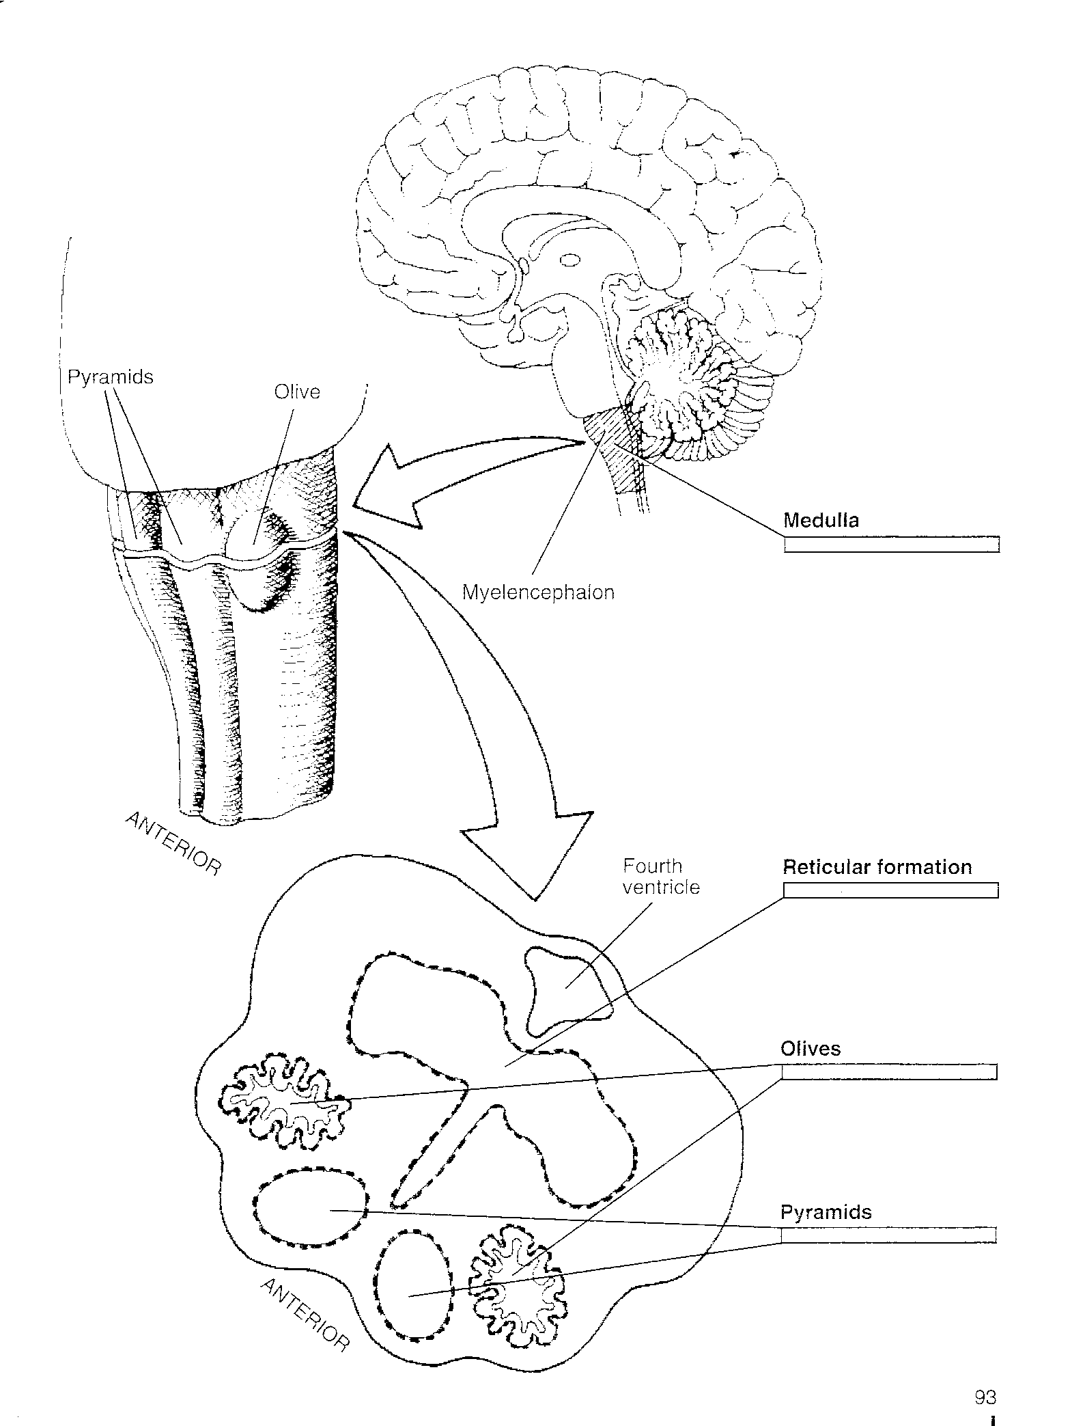

Slide 4
2. Metencephalon: (Hindbrain)
Cerebellum: coordination of movement
Ataxia- jerky inaccurate movement produced by cerebellar damage.
Cerebellar peduncles: connect cerebellum to the rest of the
brain stem.
Pons: nuclei of cranial nerves 5-8.

Slide 6
3. Mesencephalon: (Midbrain)
Superior colliculi: vision
Inferior colliculi: audition
Red nuclei: sensorimotor
Substantia nigra: sensorimotor
Periaqueductal gray: (PAG) pain & defensive behavior

Slide 7
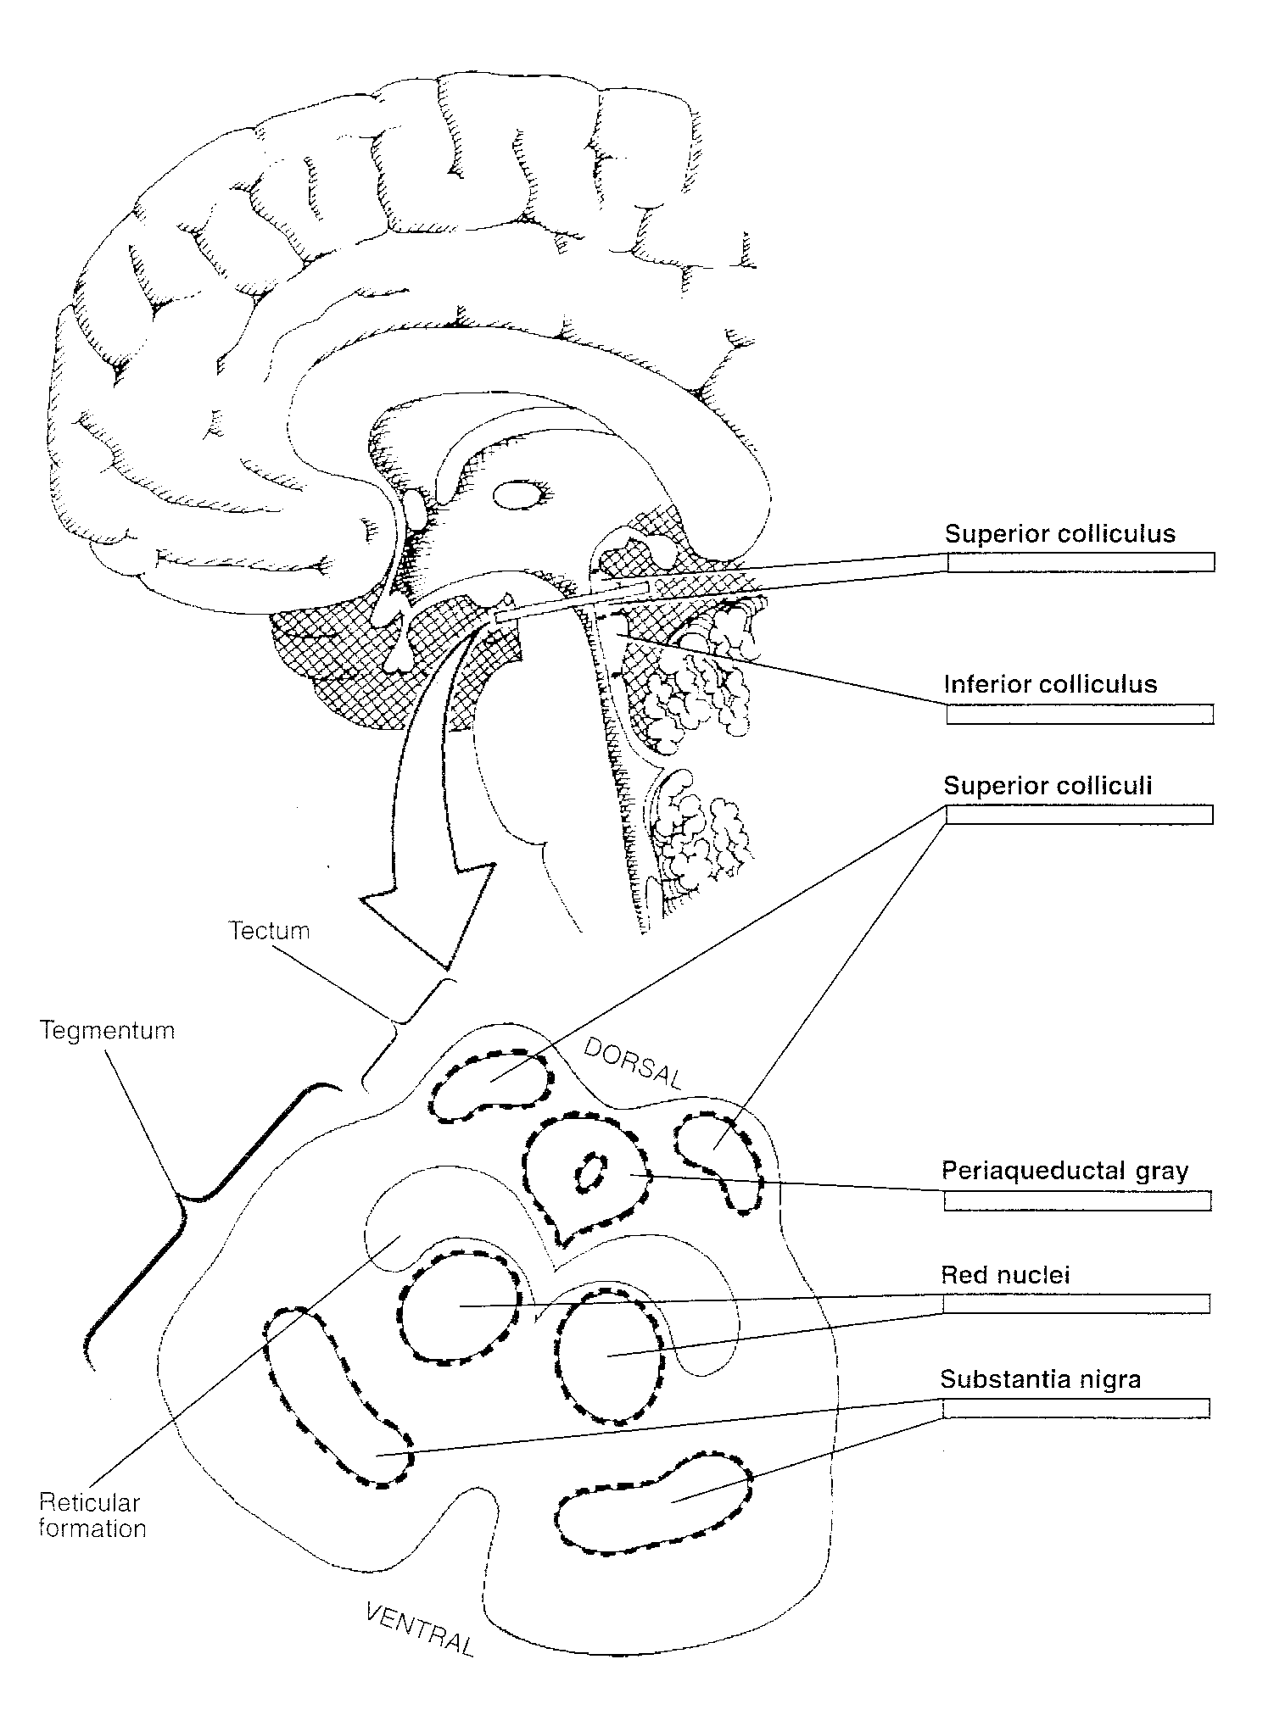

Slide 8
4. Diencephalon: (Forebrain)
A. Thalamus: sensory relay system to the cortex
Lateral geniculate: vision
Medial geniculate: audition
Ventral posterior: somatosensory
Internal lamina: white matter

Slide 9
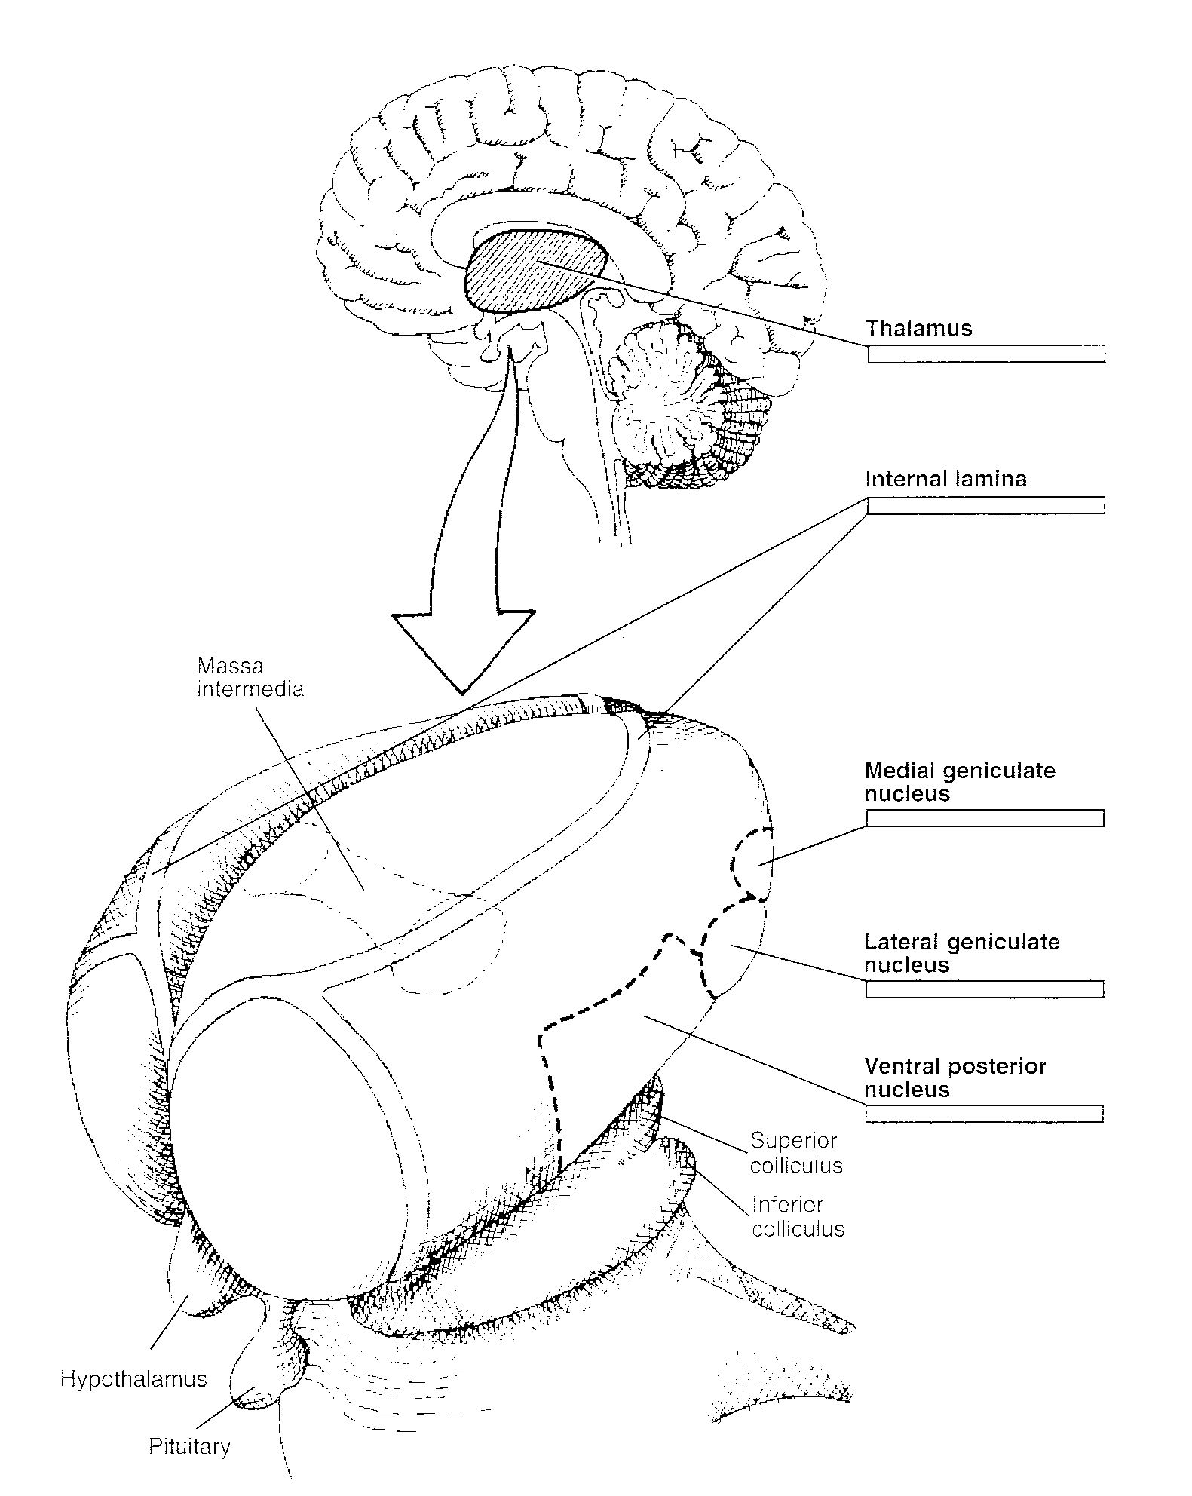

Slide 10
4. Diencephalon: (Forebrain)
B. Hypothalamus: motivation
Ventromedial nuclei: feeding
(missing is lateral hypothalamus)
Suprachiasmatic nuclei: biological rhythms
Mammillary bodies: emotion
Preoptic area: sex

Slide 11
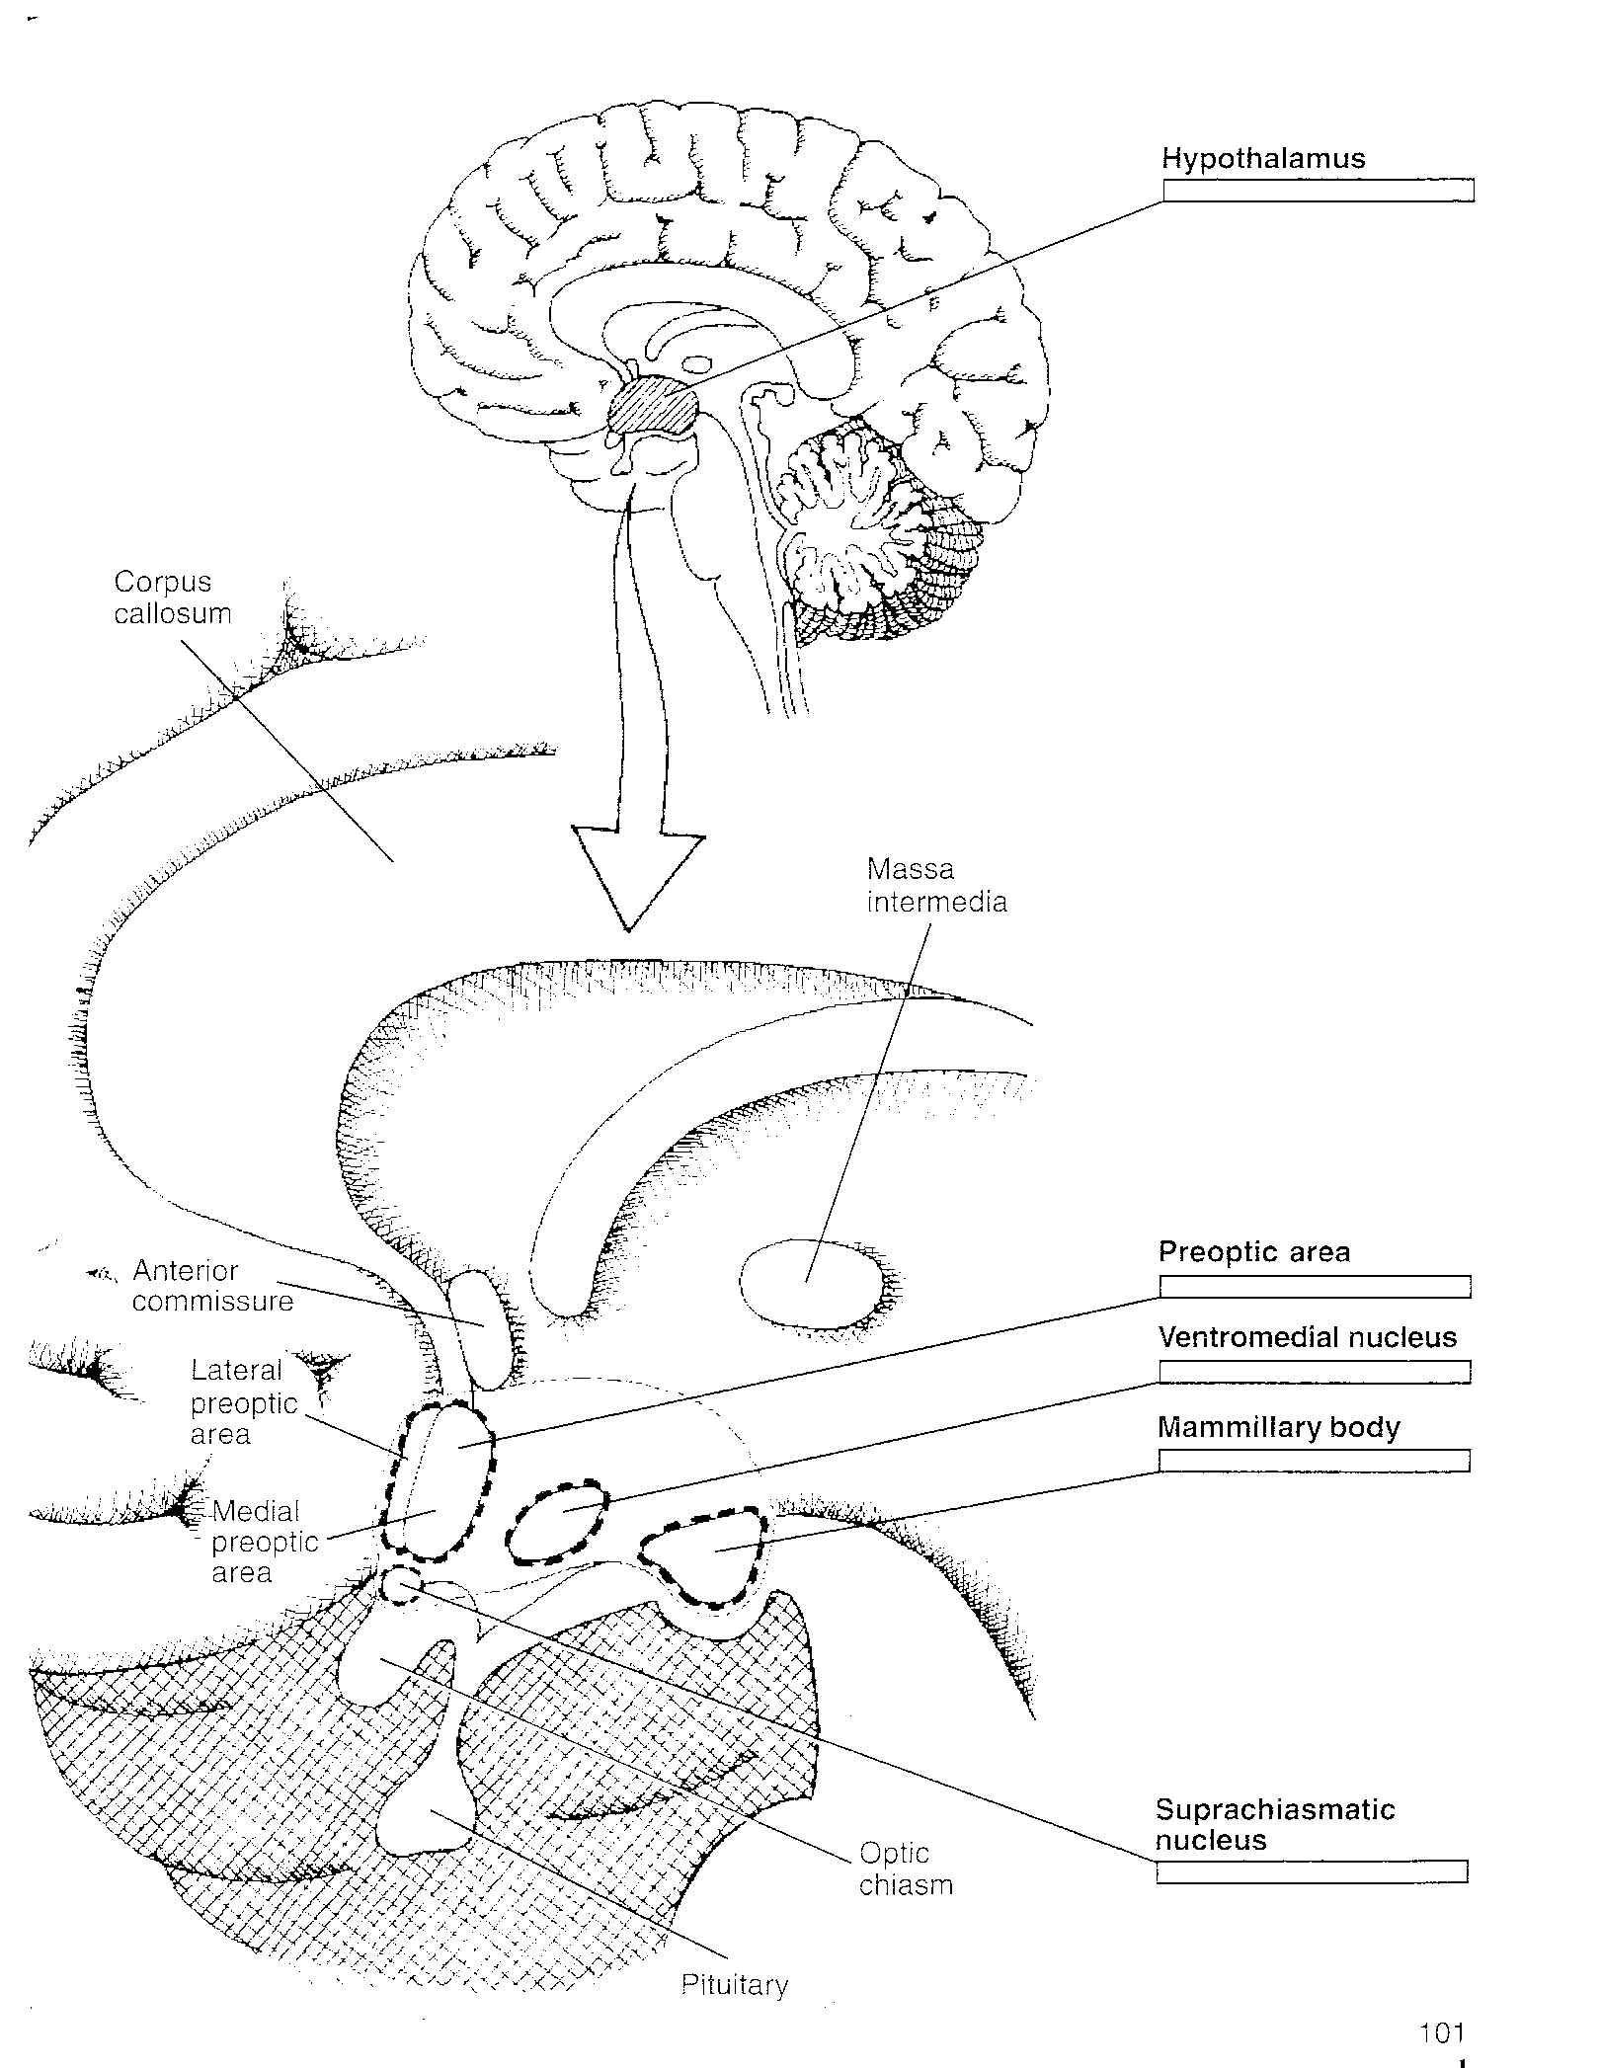

Slide 12
Posterior pituitary: innervated by the hypothalamus
Paraventricular nuclei: a hypothalamic nucleus innervating the posterior pituitary.
Supraoptic nuclei: a hypothalamic nucleus innervating the posterior pituitary.
Posterior Pituitary Releases: oxytocin & vasopressin.
.
.

Slide 13
Pituitary Gland:
Anterior: master gland
Releases trophic hormones in response to hypothalamic releasing hormones.

Slide 14
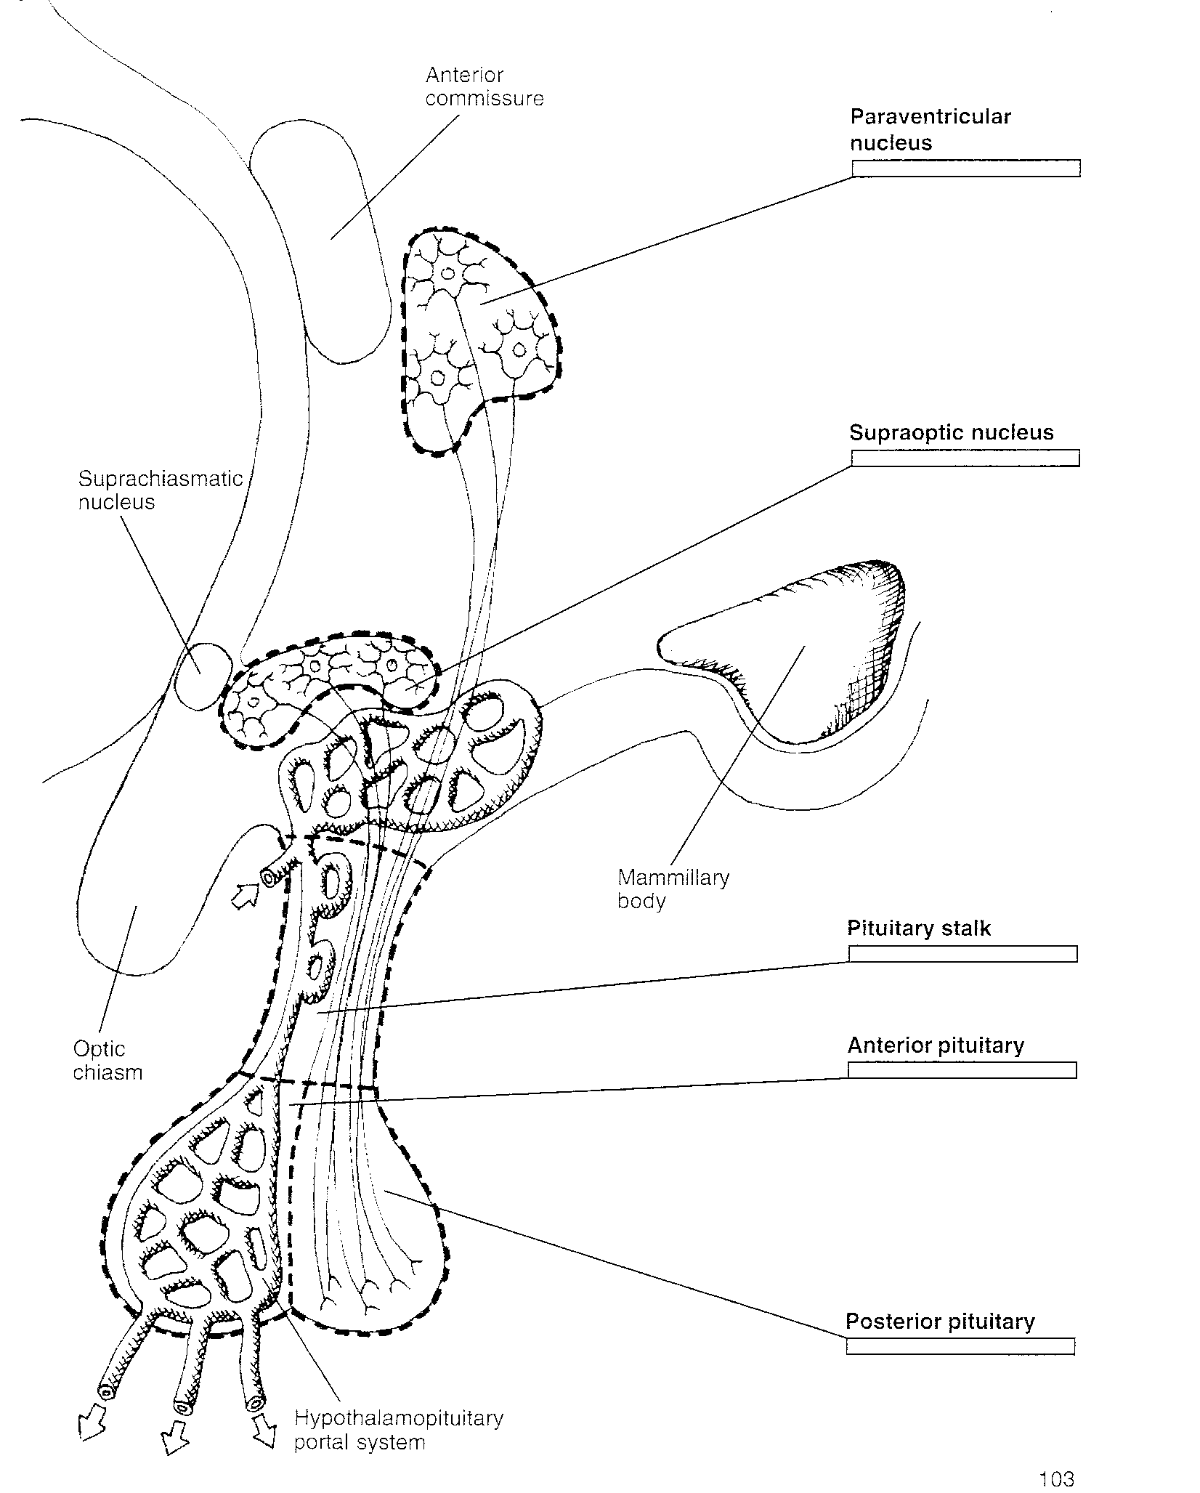

Slide 15
5. Telencephalon: (Forebrain)
Composed of cortical and Subcortical structures:
Basal ganglia (Overall role in control of movement, these structures are located lateral to the thalamus)
Caudate (tail-like shape).
Putamen: The putamen and caudate together are called the striatum (because their appearance is
striped).
Parkinson’s disease is produced by degeneration of the caudate and putamen.
Globus pallidus.

Slide 16
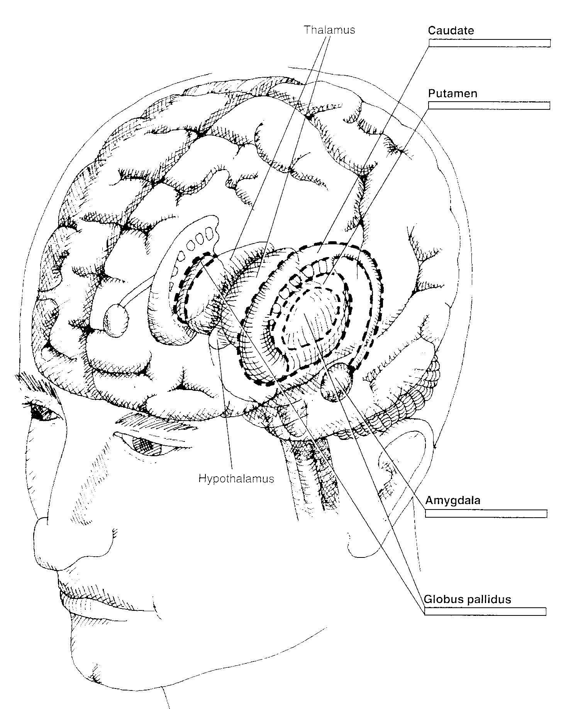

Slide 17
5. Telencephalon: (Forebrain)
Subcortical: Limbic System (motivation & emotion)
Amygdala (almond shaped) Different nuclei in the amygdale have different connections, and it can be assigned to both the limbic system (Carlson) as well as the basal ganglia.
Hippocampus: (seahorse, memory)
Cingulate cortex: (pain, depression)
Fornix: (fiber bundle: hippocampus - hypothalamus)
Septum: (sex)
Mammillary bodies: (hypothalamus – pituitary)

Slide 18
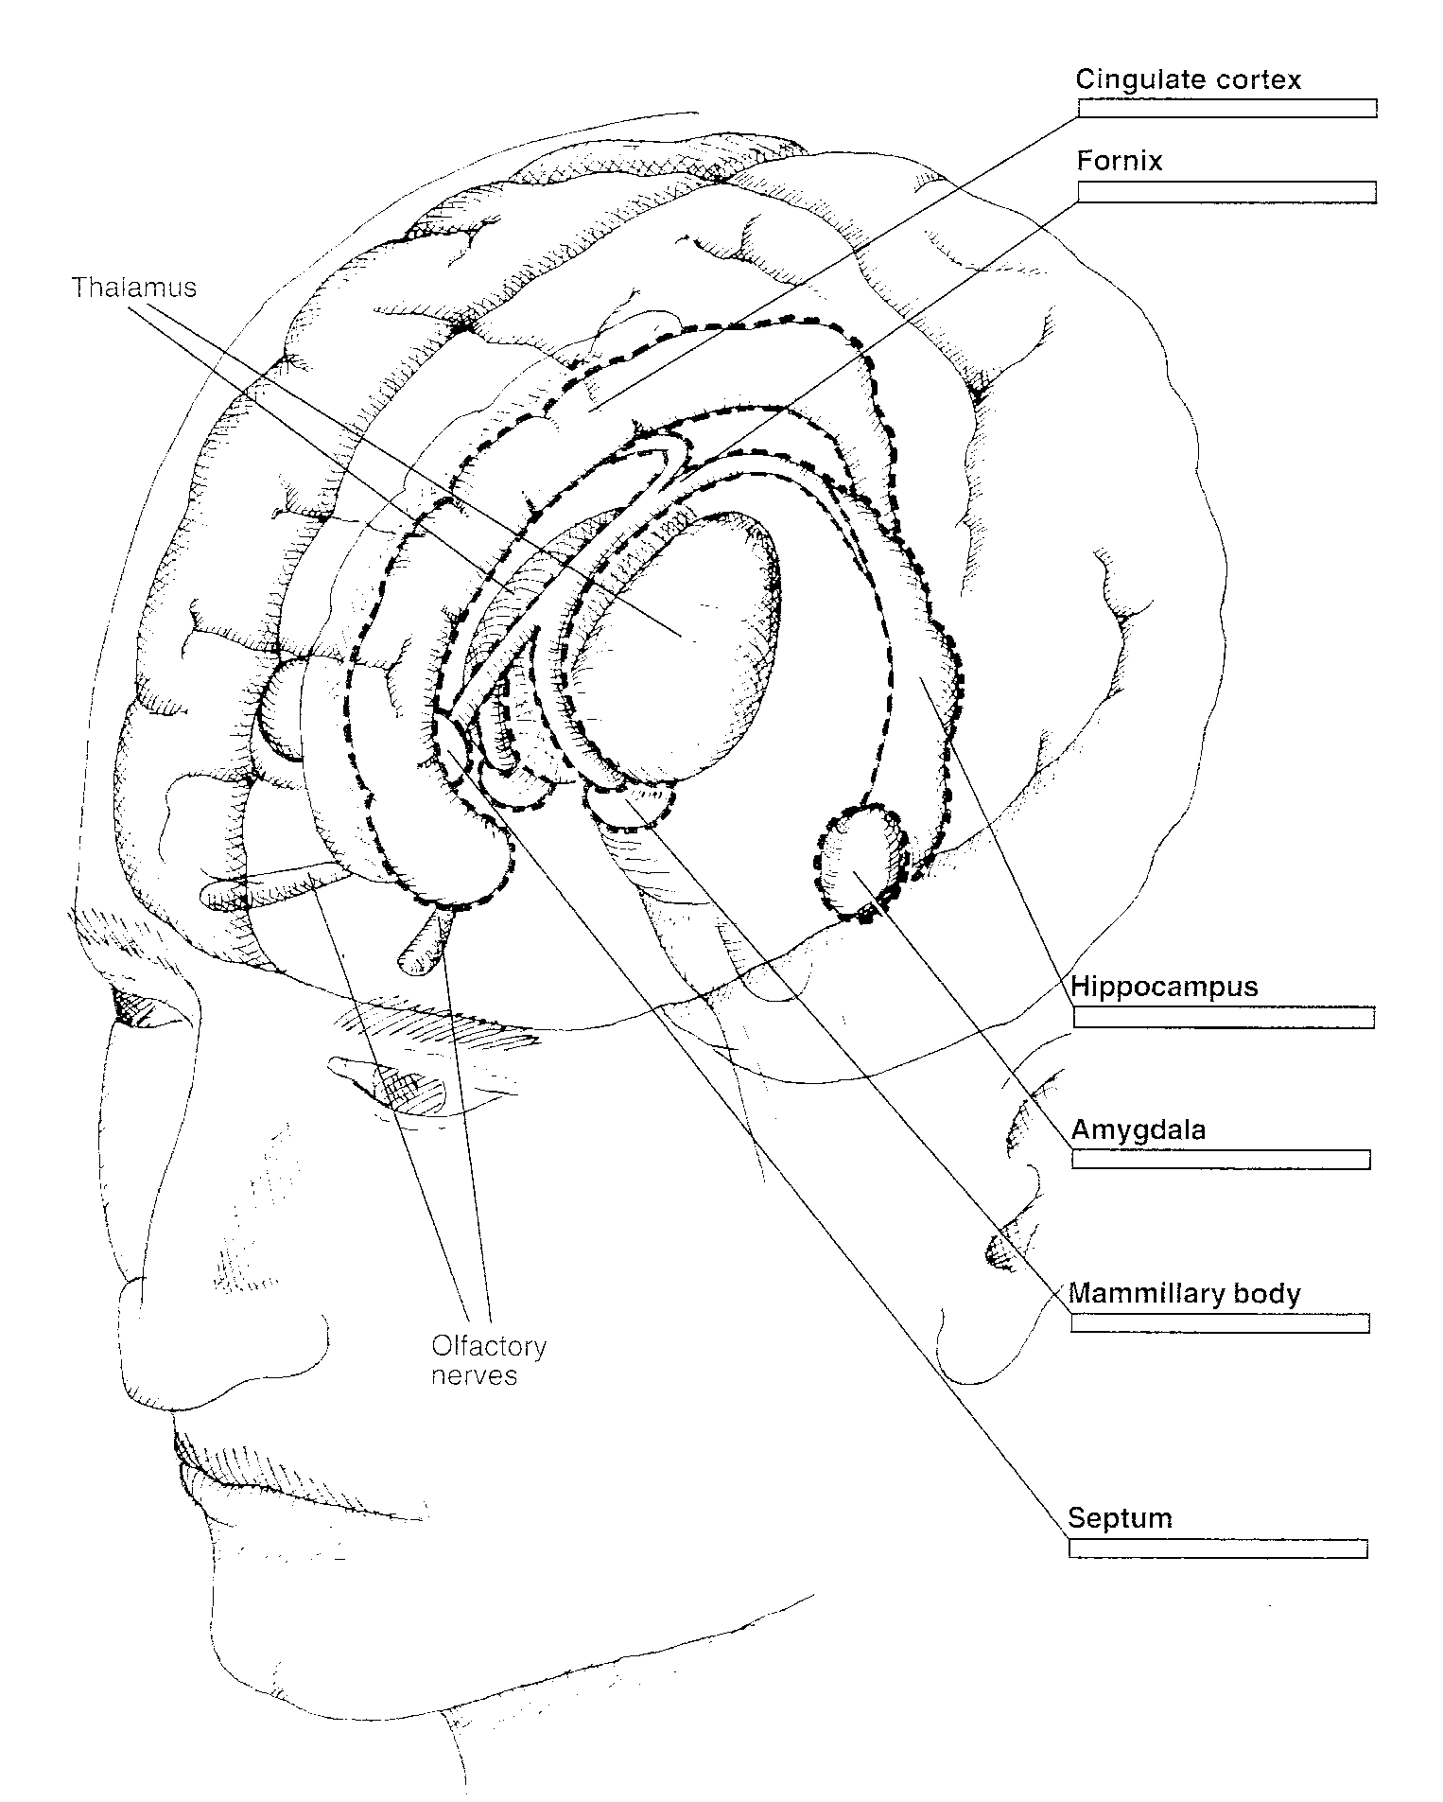

Slide 19
Telencephalon (Forebrain)
Cortical Structures
A. Frontal lobe: motor
Premotor context – planning of movement
B. Parietal lobe: somatosensory
C. Occipital lobe: vision
D. Temporal lobe: audition

Slide 20
