Slide 1
Flight Readiness Review
University of South Alabama
Conner Denton, John Faulk, Nghia Huynh, Kent Lino, Phillip Ruschmyer, & Andrew Tindell
Mentor : Richard Kramer

Slide 2
Final Launch Vehicle Parameters
Overall Vehicle Parameters
Rocket height: 94 inches
Body diameter: 4 inches
Wall thickness: 1/16 inch
Nosecone: Ogive
Fin design: Straight Tapered

Slide 3
Key Design Features
Hazard Detection Camera
capable of spotting hazardous areas through point of view analysis
Turbine Energy Conversion
on board turbine generator capable of converting energy sufficient for on board electronics

Slide 4
Final Rocket Motor
AeroTech K1103X - 14
Total Impulse: 1789 N
Pre Burn Mass: 1459 g
Post Burn Weight:

Slide 5
Rocket Flight Stability
Flight Stability: 2.49 cal
CP (Simulated): 73.621 inches from nose
CG (Experimental): 63.659 inches from nose

Slide 6
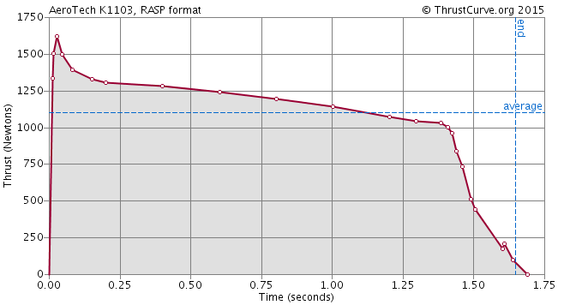
Thrust to Weight Ratio
Thrust to Weight Ratio: 16.05
Thrust: 1103 N
Weight: 247 oz. -> 7.00 kg -> 68.69 N
Rail exit velocity:
101 ft/s
Thrust curve of Aerotech K1103 motor.

Slide 7
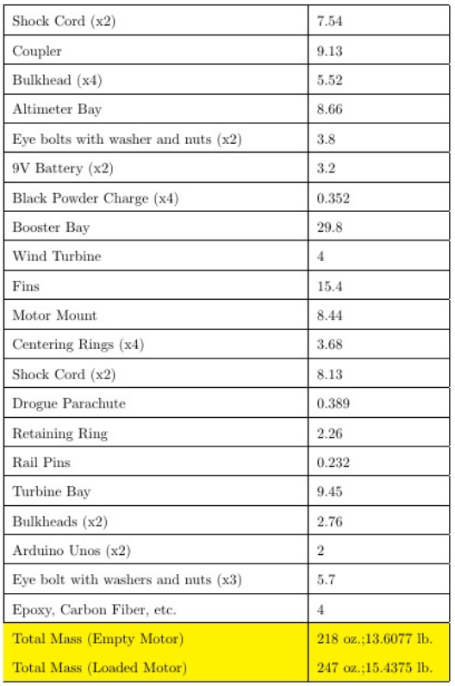
Mass Statement & Margin

Slide 8
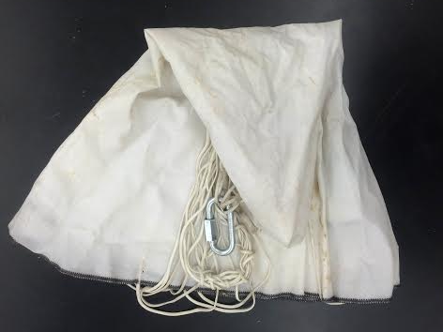
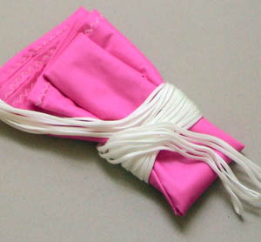
Recovery Parameters
Drogue Parachute Size: 12 inches
Main Parachute Size: 72 inches
Calculated Descent Rates:
Rocket body under drogue (white): 139.44 ft/s
Rocket body under main (pink) : 23.24 ft/s

Slide 9
Kinetic Energy Calculations
Phases | Nosecone | Avionics Bay | Booster Bay
Take-off | 86.10 ft-lbf | 894.63 ft-lbf | 1466.39 ft-lbf
Deployment | 149.30 ft-lbf | 1551.32 ft-lbf | 2542.79 ft-lbf
Landing | 3.90 ft-lbf | 40.54 ft-lbf | 66.45 ft-lbf

Slide 10
Predicted Drift and Altitude of Vehicle
Predicted drift from launch pad:
5mph – 220.87 ft.
10mph – 441.74 ft.
15mph – 662.61 ft.
20mph – 883.48 ft.
Predicted altitude from launch pad
5mph – 5407 ft.
10 mph – 5372 ft.
15 mph – 5337 ft.
20 mph – 5312 ft.

Slide 11
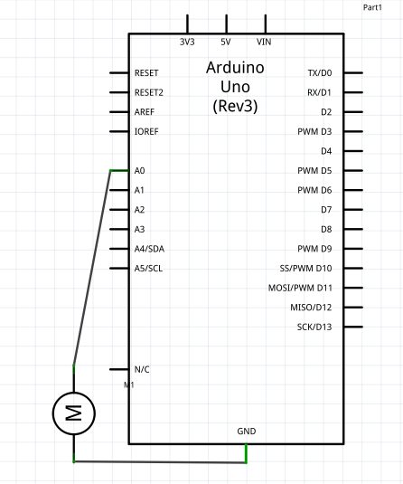
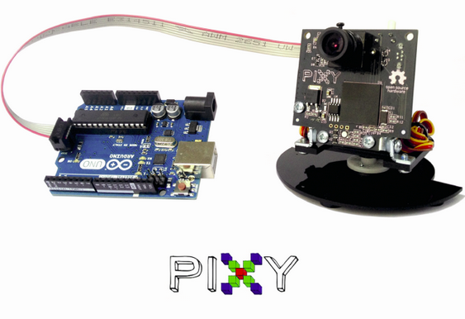
Final Payload Design & Dimensions
Turbine Schematic
Ground connection
Analog input connection
Pixy Camera Schematic
ICSP connection

Slide 12
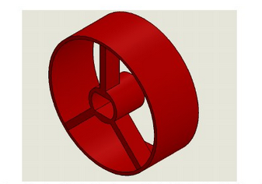
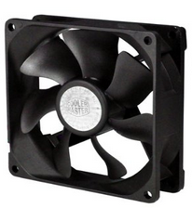
Final Payload Design & Dimensions
Turbine Tray
Secured in G10 fiberglass bay
Stationary in booster bay
Pixy Camera Tray
Need to design Pixy Camera Tray
Secured in G10 fiberglass bay
Plexiglass bulkhead

Slide 13
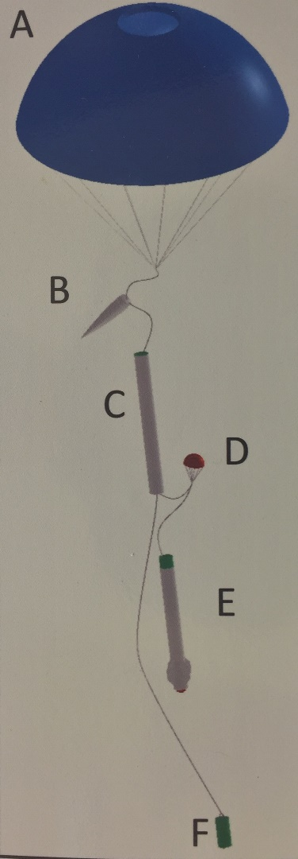
Payload Integration
Vehicle Attachment Scheme
Main Parachute (A): Deploy at approximately 700ft
Nosecone (B): Will deploy with main parachute
Avionics Bay (C): Houses hazard detection camera, altimeter, and parachute until apogee
Booster Bay (D): Houses shock cord, motor, and turbine generation payload
DC Wind Turbine (D): Housed in booster bay
Turbine tray: round with spokes
Directed air flow piping
Hazard Detection Camera (F): Located in coupler
G10 Fiberglass Bay & Bulkhead
Plexiglass Bulkhead

Slide 14
Interfaces with Ground Systems
Stratologger #1: Will deploy both main designated altitude and drogue at apogee
Stratologger #2: Designated as scoring competition altimeter
PixyCam: Hazard detection payload capable of determining position away from descending vehicle
Turbine Generator: Generates and logs the amount of current produced in order to prove that it can be used it further projects to power on board electronics

Slide 15
Payload Test Plan
Hazard Detection Pixy Camera
Test outside in normal climate conditions
Hinderance of weather conditions
Effects of sunlight
Further equation accuracy testing
Uniquely colored tarp for color ID
Camera coordinates
Absolute coordinates
Full scale testing
Ejection from avionics bay
Tangling with shock cord
Tilt during descent
Plexiglass clarity
Failsafe Drogue Deployment Turbine
Full scale turbine voltage test with air jet
Multimeter voltage testing
Arduino Uno data logging
Wind Tunnel Testing
Airflow scoop stability
Velocity of interior air flow
Voltage testing
Directed airflow piping
Determine optimum piping positioning
Max voltage allowance

Slide 16
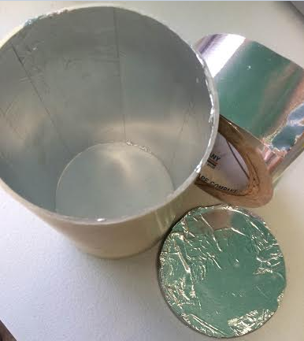
Recovery System Tests
Black Powder Charge Ejection Tests
~2.0 grams (unsuccessful)
~2.5 grams (successful)
Altimeter Tests
Vacuum testing
Electrical disturbances
Aluminum tape

Slide 17
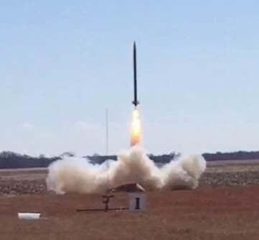
Full Scale Flight Tests
First Full Scale Flight:
Apogee: 3507 ft.
Deployment: Dual with main parachute at 700 ft
Overloaded black powder charge so both parachutes deployed at apogee
Second Full Scale Flight:
Apogee: 2203 ft.
Deployment: Dual with main parachute at 700
Successful launch and recovery
Full scale test flight.

Slide 18
Summary of Launch Vehicle Requirement Verification
Successful sub-scale launch
Safe full-scale launch
Static ground testing
OpenRocket simulations
Future parachute drag analysis

Slide 19
Summary of Payload Requirement Verification
Sub-scale mass simulations
Full-scale mass simulations
Static ground testing
Wind tunnel testing
Drop testing of camera bay
Air jet testing of wind turbine

