Slide 1

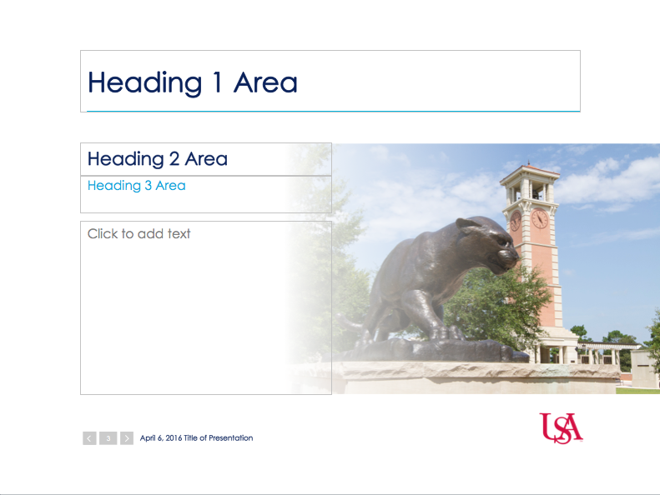
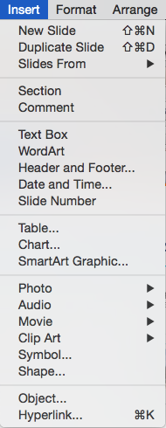
PowerPoint Instructions (delete this slide when finished)
To add a new slide, select the New Slide drop down menu in the upper left-hand corner of the menu bar. There are many templates to choose from, and they are all editable.
You can use or delete any of the text boxes in each template slide. If you do not put any content in the boxes, they will not be visible in the presentation.
To add a text box, chart, photo/image or any other element, click on Insert in the menu bar.
Add the date and presentation title at the bottom of the slide. Page numbers are automatically generated.

Slide 2
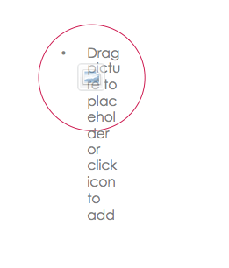
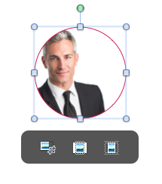
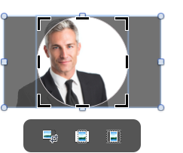
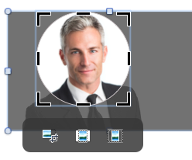

PowerPoint Instructions (delete this slide when finished)
On slides that allow you to insert an image, click the icon in the center of the shape.
Select the photo you would like to use.
Hold Shift and drag the corner of the photo to the desired size. You can also drag the photo to the center. Make sure the photo touches all edges of the shape, filling the entire space.
You will want to center and enlarge as needed.
Select the left icon. This will allow you to edit the photo.
When finished, click off to the side.

